Slide 1
54th Annual NCDA Conference Orlando June 13- 15, 2022

Slide 2
CDBG MANAGING INFRASTRUCTURE/NEIGHBORHOOD IMPROVEMENT PROJECTS
George Mensah
Director
Department of Housing and Community Development
City of Miami

Slide 3
Facts about City of Miami
Settled in 1825; Incorporated on July 28, 1896
Government: A City Mayor, elected by entire City, and five District-elected Commissioners
2020 U.S. Census population, Miami (April 1st): 442,241
Foreign-born population: 57.5%
Median HH Income, City-specific: $48,789
CDBG Allocation Program Year 23-24: $5,348,046.00

Slide 4
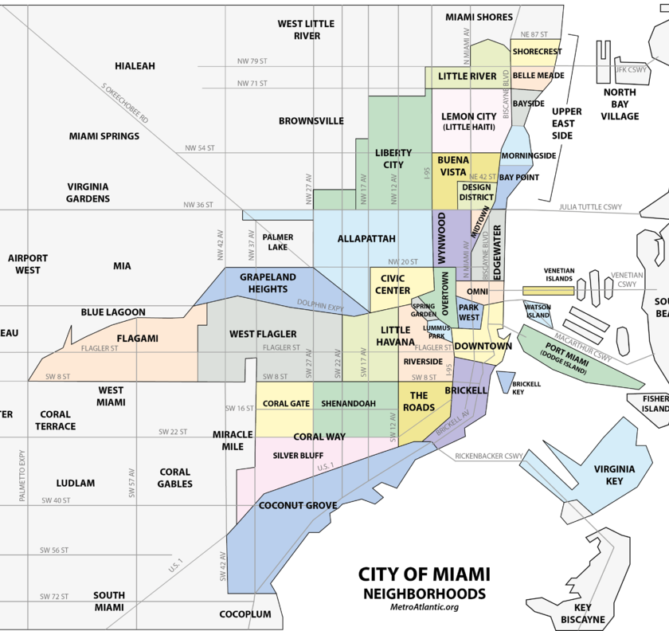
Facts about City of Miami

Slide 5
Infrastructure Project Selection I
The City has identified the following infrastructure projects as priorities
Building and replacement of sidewalks in CDBG eligible communities as a priority.
Street pavement replacement or reconstruction, drainage improvements and ADA ramps in CDBG eligible communities
On an annual basis, $600,000 in CDBG Economic Development funds are allocated to the City’s Resiliency and Public Works Department
The rest of the CDBG Allocations are divided using CDBG Formula A allocations per City Commission District.

Slide 6
Infrastructure Project Selection II
Citywide Projects
Department of Resiliency and Public Works (RPW) maintains a city street inventory that requires repaving or reconstruction.
RPW selects the streets to be paved and the scope of work which includes sidewalk replacement, curbs and ADA ramps, as well as drainage improvement, if needed to the department.
The department reviews the selected projects for CDBG eligibility
Meets a national objective
In a CDBG eligible area (used primarily by low-income individuals)
Scope cannot be classified as maintenance
Contract is competitively procured

Slide 7
Infrastructure Project Selection III
District Projects
Selected based on the priority of the district during public hearings
Examples of Projects:
District specific street and sidewalk replacements
New playground installations
Rehabilitation of properties for non-profits
Rehabilitation of community centers in parks

Slide 8
Procurement
City Projects
Procurement is done through the Procurement Department
All construction services in the city are procured using federal procurement regulations
Example: Davis Bacon and Section 3
Non-City Projects
Procurement conducted by the sub-recipient
Supervised by the department

Slide 9
Contracting
For City Projects
An MOU is executed between the department and the city department responsible for managing the project (Public Works or Office of Capital Improvements)
The MOU makes the department jointly responsible with he contracting department for the management of the contract.
MOU includes monitoring language that allows the department to monitor the other department for compliance.
Non-City Projects
Contract is executed between the City and the non-profit
Non-profit is solely responsible for the management of the project

Slide 10
Project File
Project Transmittal Form
Executed contract or MOU
The MOU makes the department jointly responsible with he contracting department for the management of the contract. Or
Executed contract with non-profit
Map of the project area
CDBG eligibility analysis form
Scope of work
Environmental Review Forms
Davis-Bacon & Section 3(resides in a separate file with responsible staff)
Other documents
Reimbursement forms, before & after pictures, notice to proceed etc

Slide 11
Reimbursement Process I
Contracting department or non-profit submits a reimbursement package
Reimbursement form
A completed AIA from form the contractor signed off by the contracting department or non-profit
Davis-Bacon and Section 3 information
Contract Compliance Analyst reviews the package and signs off on the form
Department’s construction inspector visits the site to ensure that the percentage of completion is as specified on the AIA and signs off on the reimbursement

Slide 12
Reimbursement Process II
Staff responsible for Davis-Bacon and Section 3 reviews the package and signs off on it or request additional information
Package then goes to finance unit for payment
Fiscal assistant reviews package to ensure that it includes all the required signatures, and the math makes sense. Inputs in financial system
Package is reviewed by Assistant Director for Finance and approved for payment
Department director or his assignee reviews and approves for payment
The Department’s standard is to complete the reimbursement process in 14 business days.

Slide 13
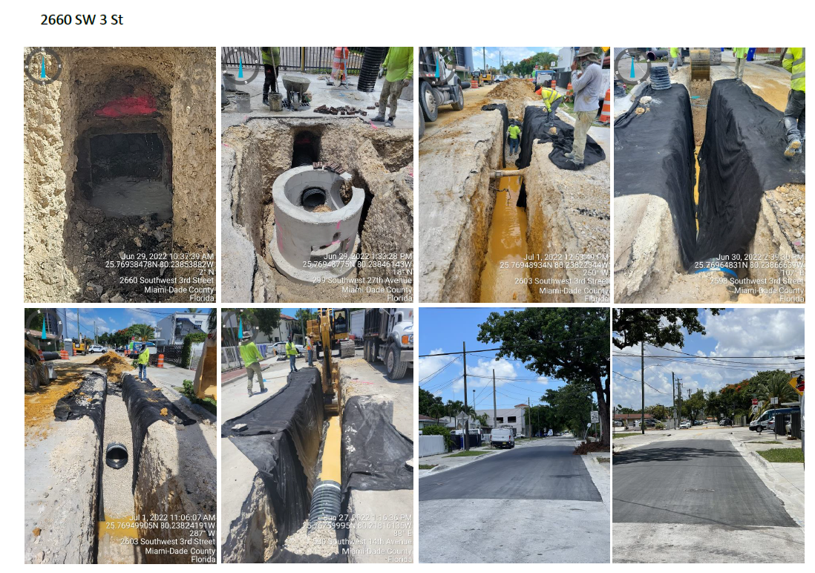

Slide 14
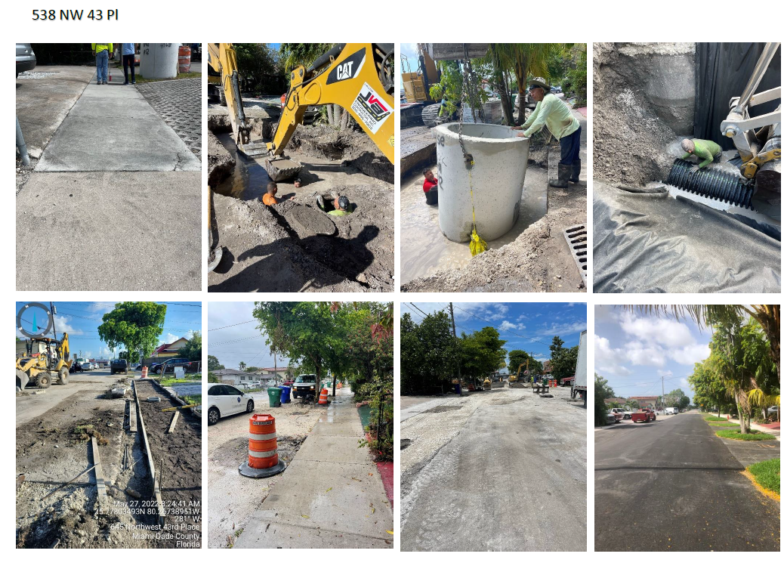

Slide 15
Caribbean Marketplace

Slide 16
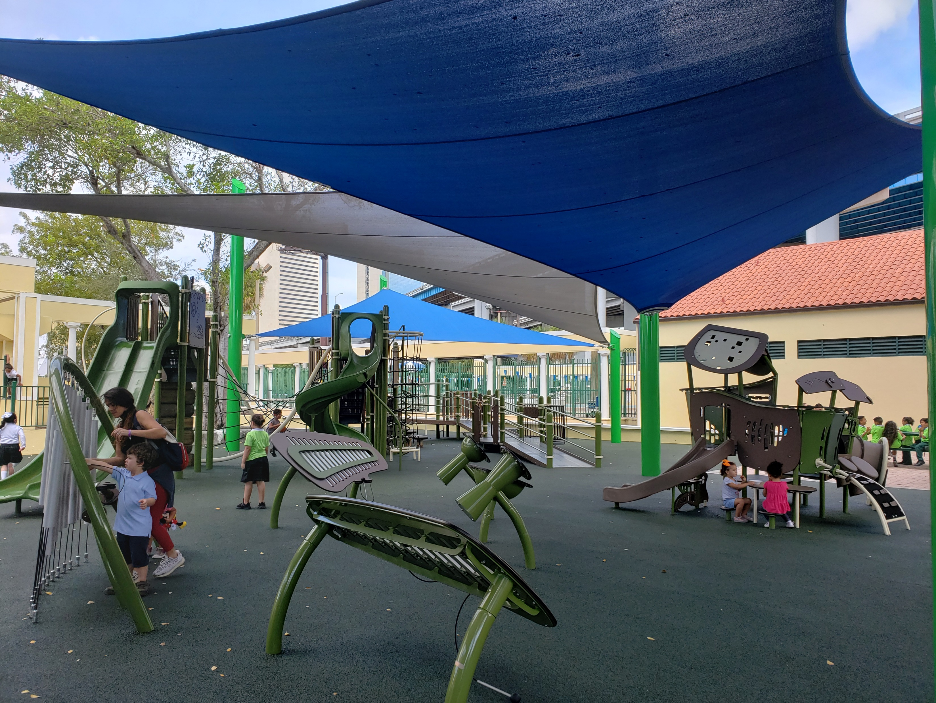
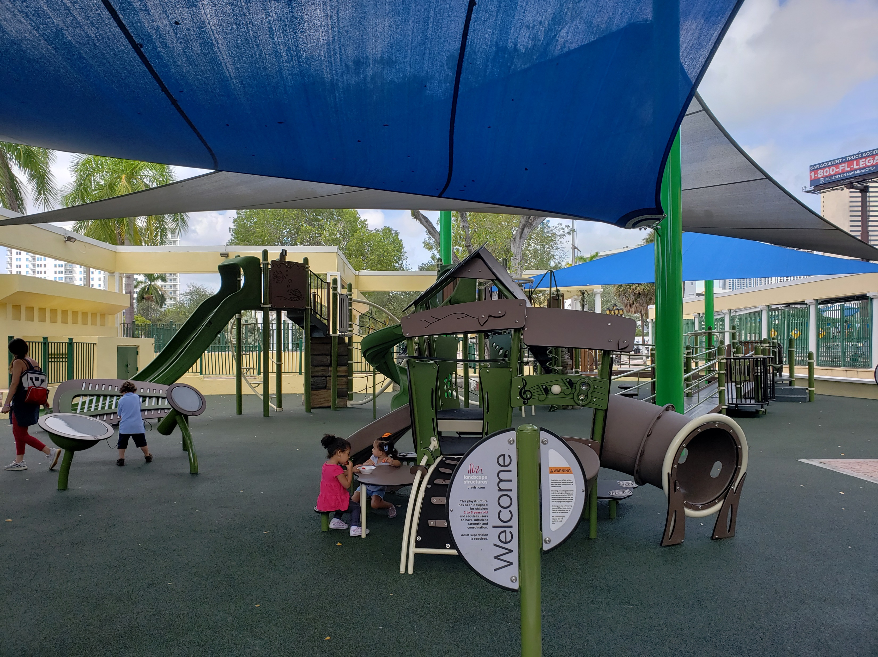
Jose Marti Playground

Slide 17
Coral Way Park Playground

Slide 18
Lessons
MOU with City Department should include monitoring and monitor based on your monitoring policies and procedures (from HUD monitoring)
All city infrastructure construction contracts should use federal procurement standards-reduces drastically project time
In reviewing eligibility be cognizant of who uses the infrastructure ( Ex. Is the road primarily used by commuters not living in the community?)
Ensure that the eligible areas are primarily residential
Ensure you have project signs that shows the use of CDBG funds
Always try to have a “groundbreaking ceremony” or a “ribbon cutting ceremony” so your politicians, especially your congressional delegation, can take credit for the work done using CDBG funds in the community.

Slide 19
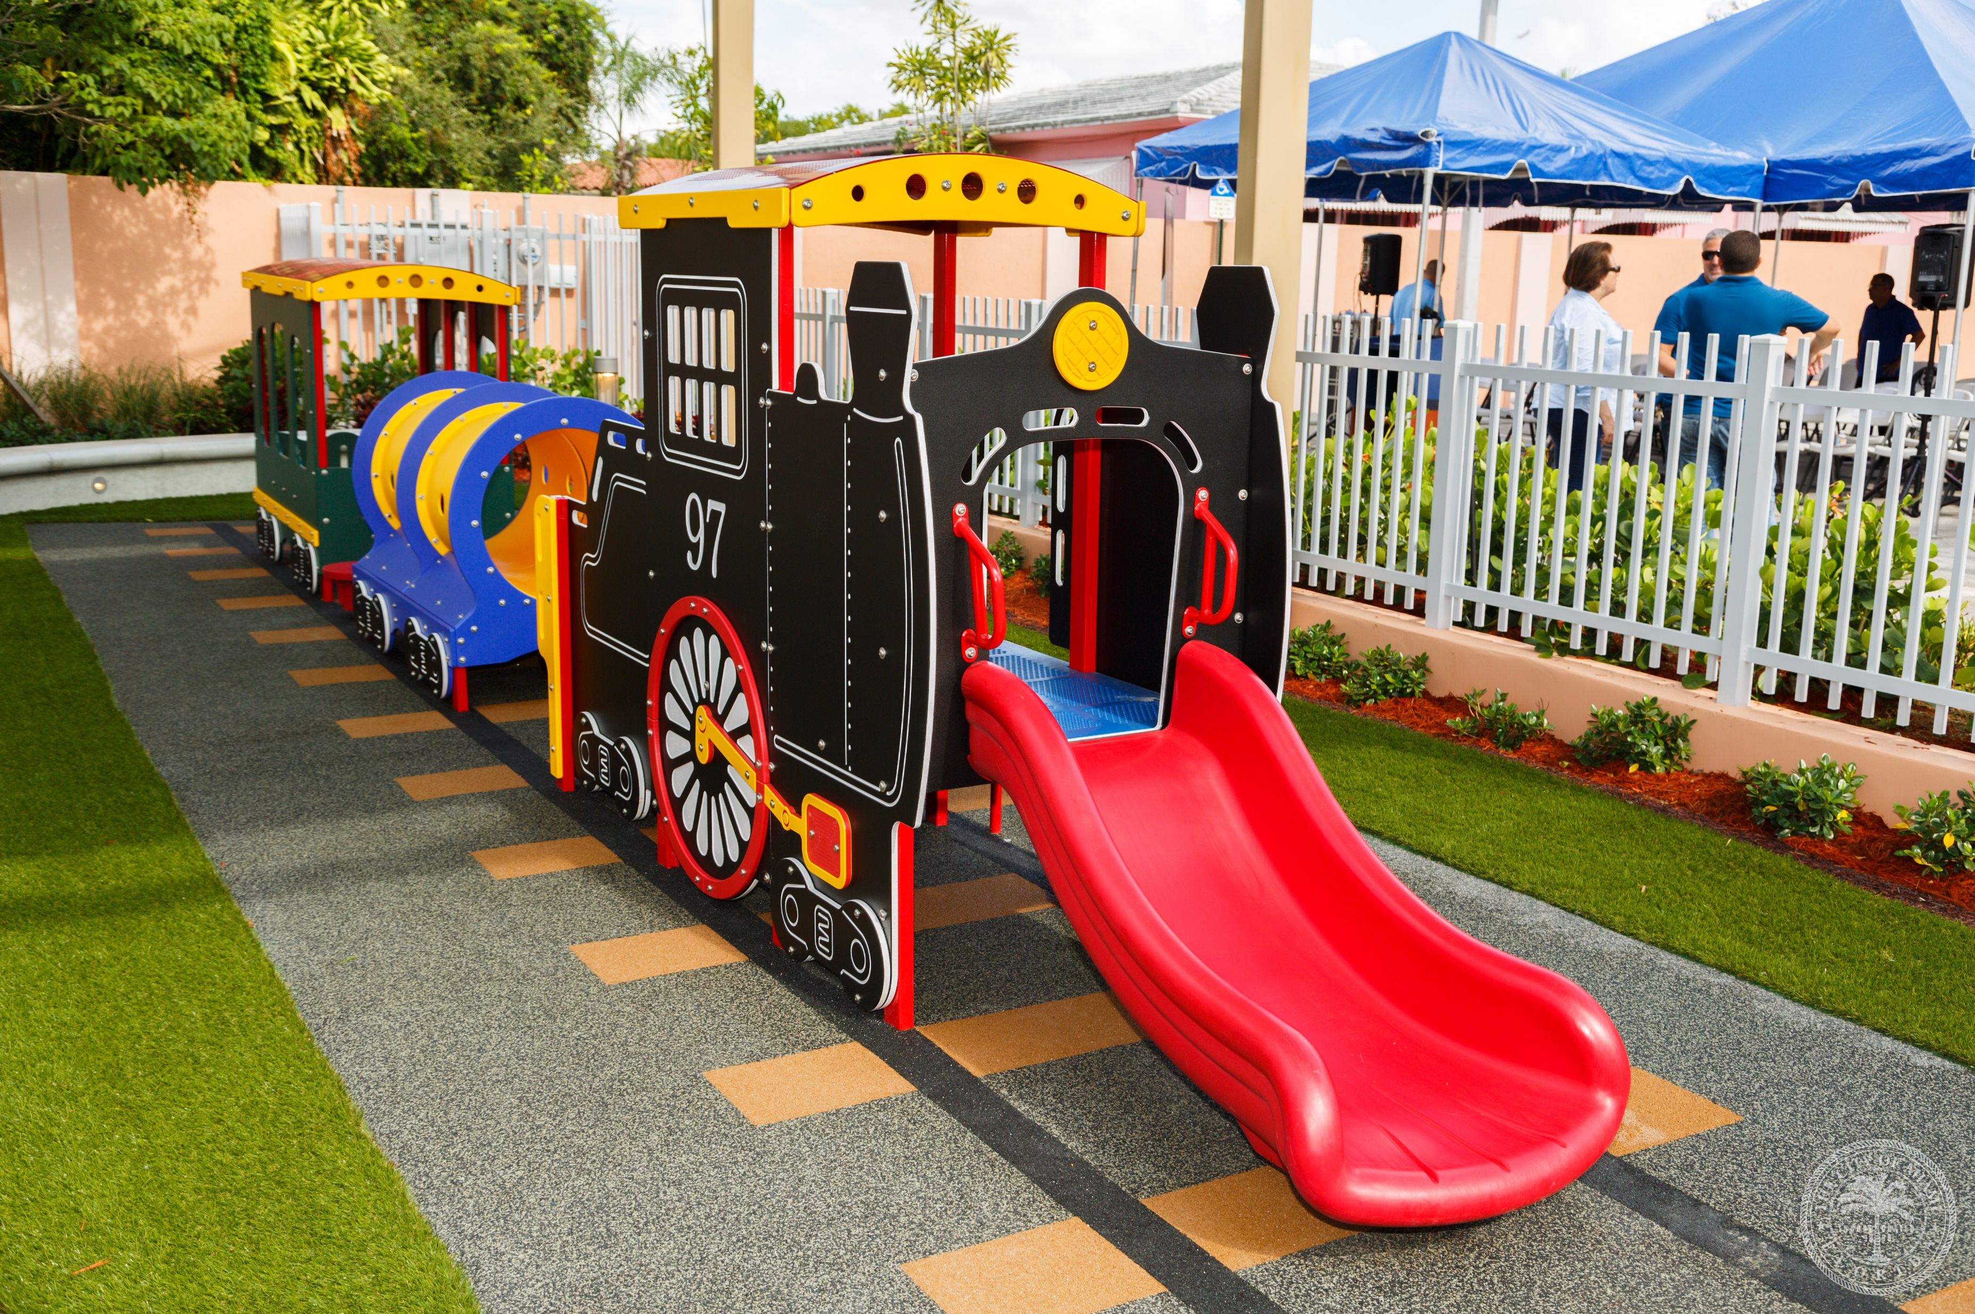
The Train

Slide 20
Questions?

